Slide 1

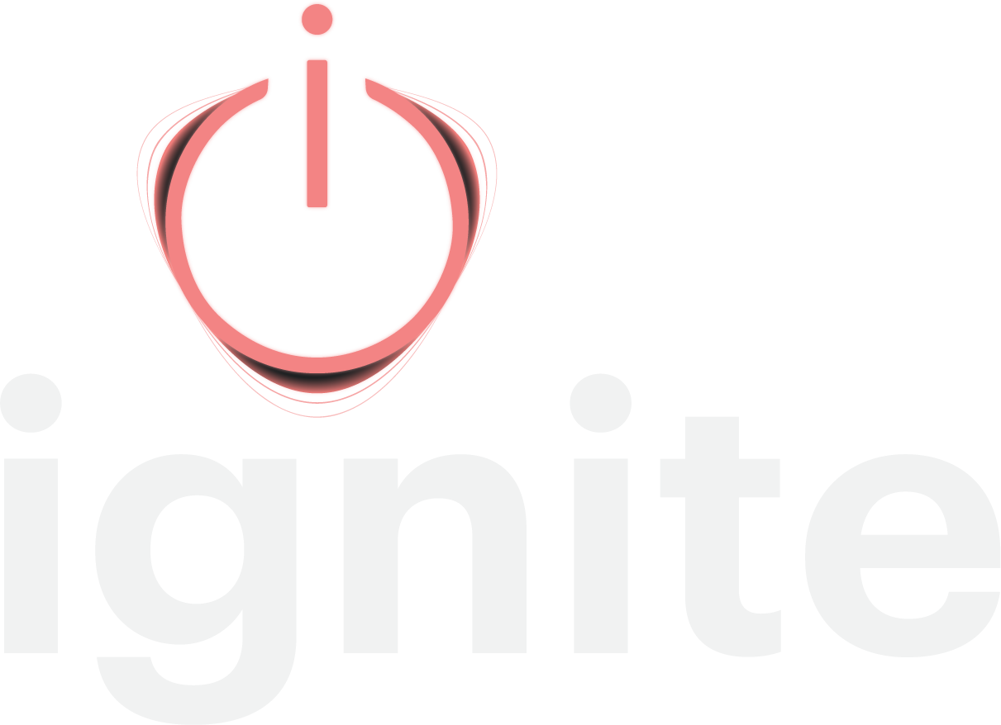
The Revenue Growth System
for multi-property portfolios
Revenue management decides what to charge tonight. Ignite decides where next year's growth comes from, and who has to do what to get it.
do less. make it mean more.
THE PROBLEM
Your commercial team has never been busier. That is the problem.
A hotel in a major leisure market celebrated a 16:1 return on ad spend. It was aimed at the hotel's least valuable segment, where the bar was 22:1. A loss, applauded. Nothing in the stack was broken. It was grading the work against the wrong customer.
5%
of sales and marketing tactics aimed at the most profitable segments
$1.3M to $2M
estimated missed revenue in one 100-room asset in a tertiary market
60+ reports
across seven systems, and no central hub
15.5 hours
per hotel, at a management group, on a plan nobody used
THE SOLUTION
Know where next year's growth comes from.
The Ignition Score ranks segments, accounts, and actions by revenue and profitability together, so "most valuable" stops being an opinion. Each property gets a ranked next move with the reasoning attached. It sits above your RMS, never in place of it.
STRATEGY BETA GROUP
$20,000 per account. Three to five members.
Not investors. Cash for access, not equity for access. Each member commits several properties and defines success in writing, in their own numbers, before day one. You are not buying software at a discount. You are building the proof.
THE CHARTER RATE
20% under list for three years.
After general availability, on every property you bring on, not just the beta ones. Onboarding waived. Does not stack with other multi-year discounts. Offered once, to this first group. The wider you roll it out, the more it pays.
WHAT MEMBERS GET
• Ignite across your committed properties
• A direct hand in the multi-property build
• Your portfolio's patterns in the engine first
• Kate Burda & Company alongside your team
• The Charter Rate when the beta ends
STRAIGHT TALK ON FUSE
Live today: the Revenue Roadmap, Ignition Score, STR and CoStar benchmarking, the Sales, Marketing, and ABM engines, and Iggy.
Fuse, the multi-property layer, is not built yet. We are building it now, with the members who will run it.
MEET THE CORE TEAM
Kate Burda, Founder
Eddie Westerfield, Chief Technology Officer
Recardo Poole, UI/UX
Tristan Carty, Operations
Four builders, which is why it is three to five members and not thirty.
NEXT STEP 45 minutes. Nothing required from your side.
Watch Ignite run on Flying Horse Resort & Club's live data, with their permission,
or on public data from your own market. Somebody else's numbers first, then yours.

